Slide 1
SchoolsOnline:
The Digital Pathway

Slide 2
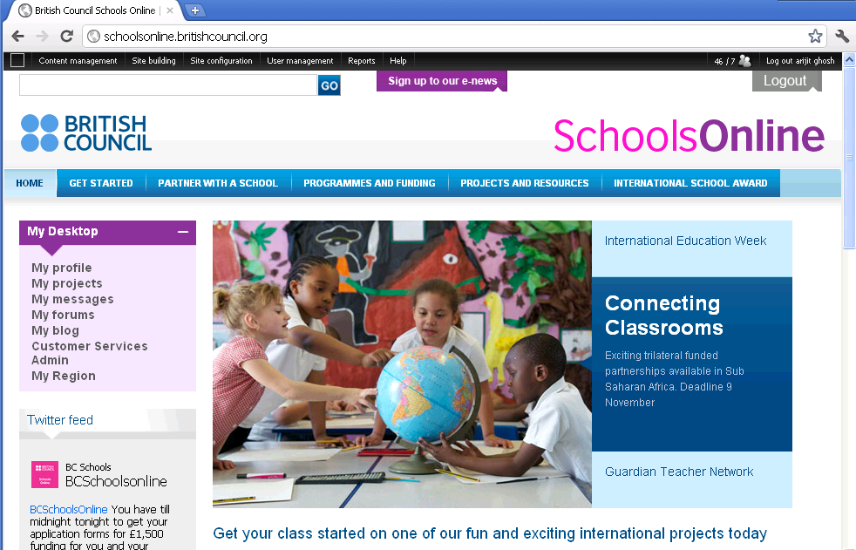
SchoolsOnline: A virtual tour
http://schoolsonline.britishcouncil.org/

Slide 3
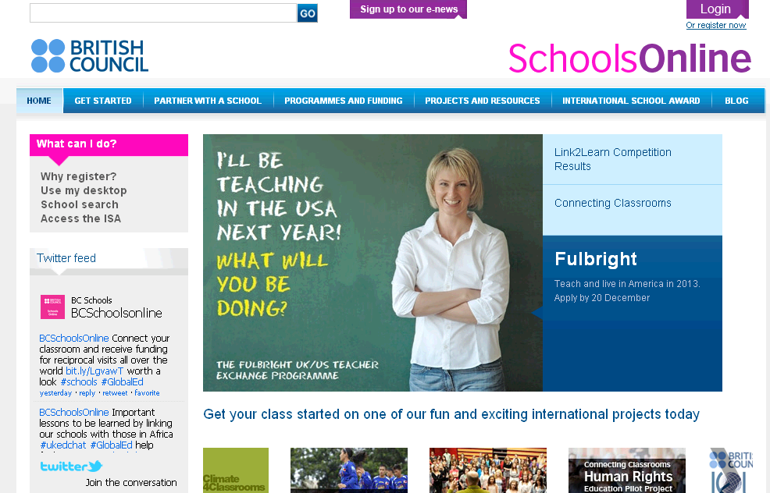
Click Login or Register now

Slide 4
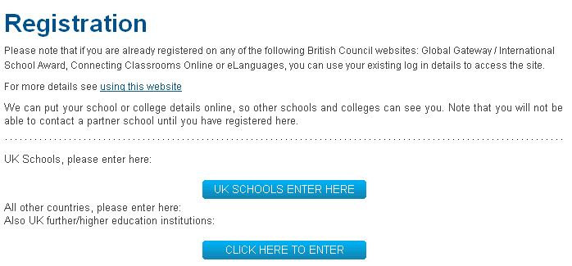
Click here

Slide 5
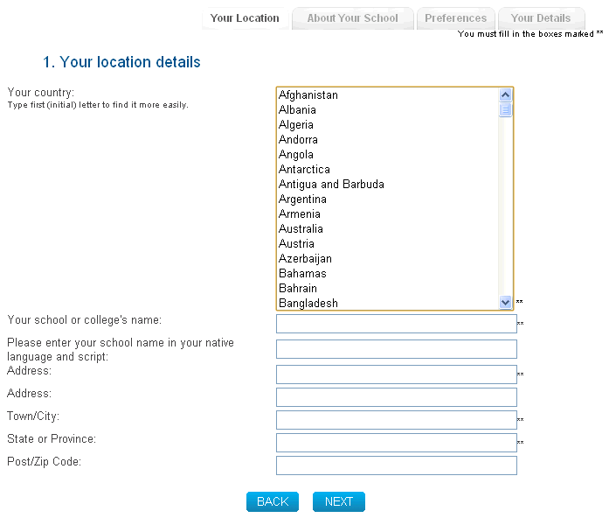
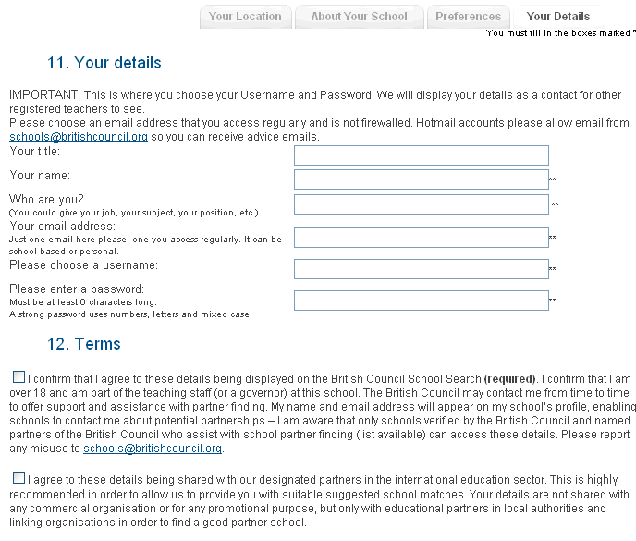
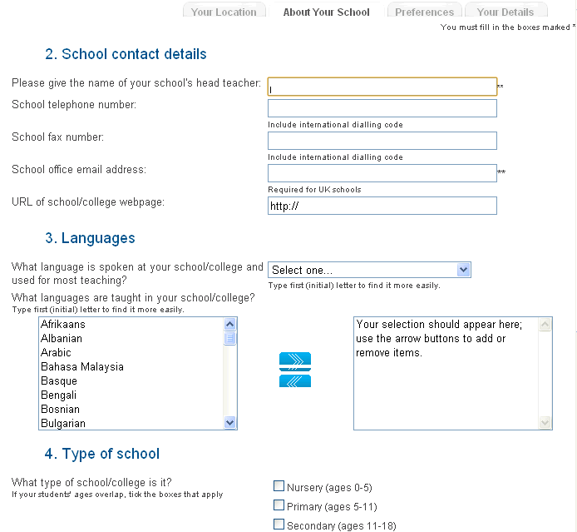
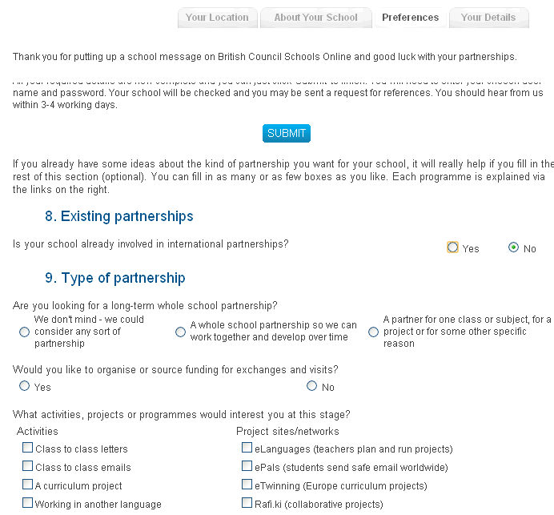
Fill out the multiple page registration form providing details of the school
On the last page choose your username, password and enter your e-mail

Slide 6
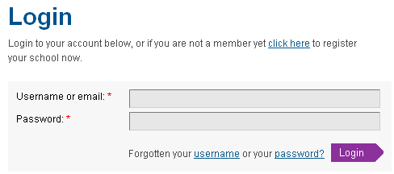
If you are already registered, enter your username and password on the Login page to get started

Slide 7

Successful login will show your username and the caption Logout on the top right-hand corner of the SchoolsOnline homepage

Slide 8
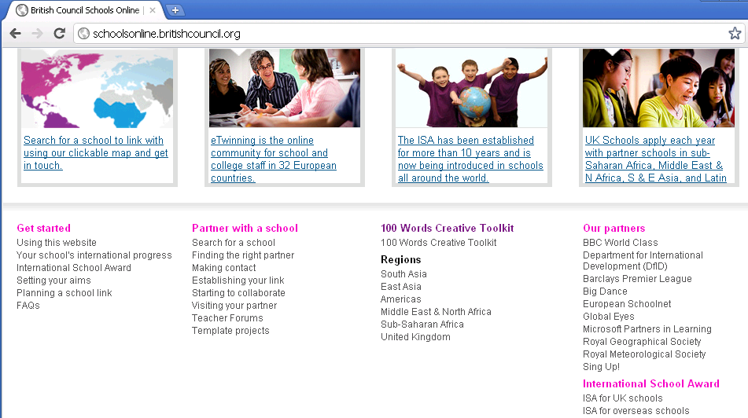
Scroll down on the homepage and click South Asia
Click here

Slide 9
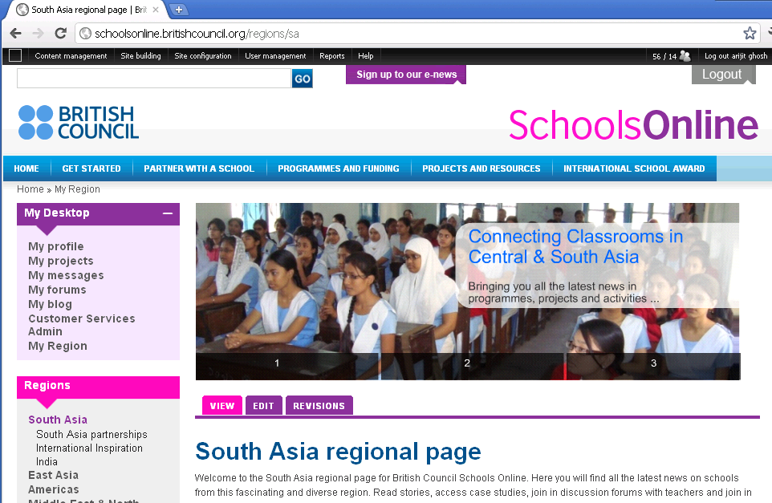
At the South Asia regional page, click India
Click here

Slide 10
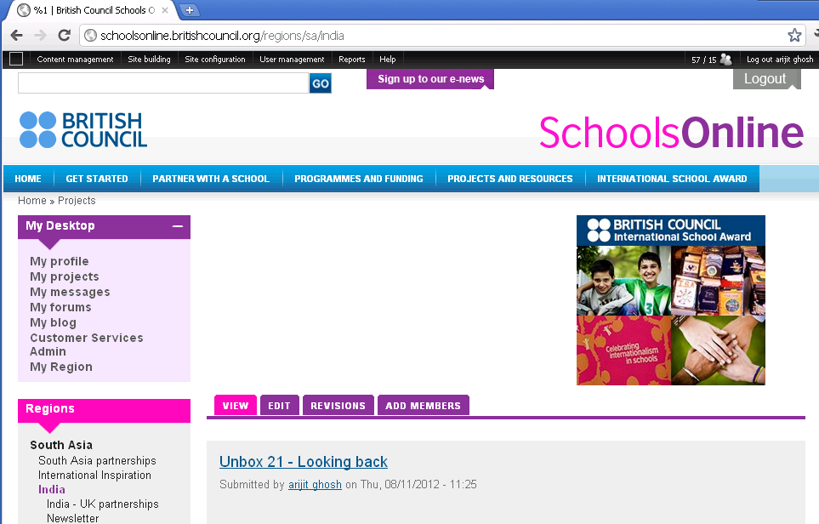
This is the India page of SchoolsOnline
http://schoolsonline.britishcouncil.org/regions/sa/india

Slide 11
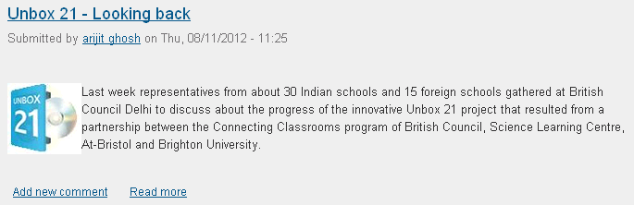

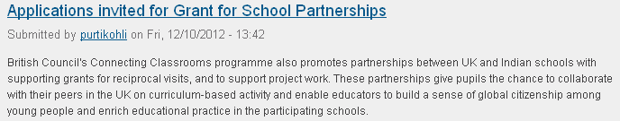

Information about latest projects and happenings can be found here

Slide 12
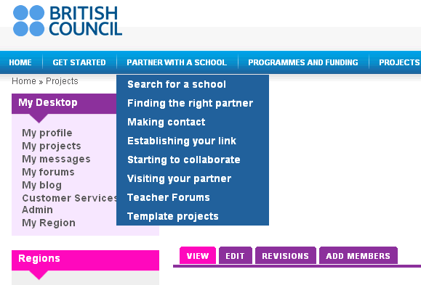
All relevant information about partnerships with a different school can be found here
Click here for a dropdown

Slide 13
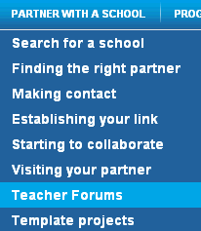
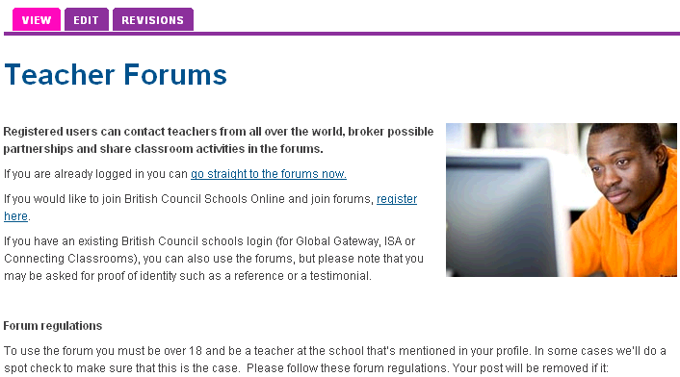
Click Teacher Forums from the dropdown
to connect and interact with teachers across the globe.

Slide 14
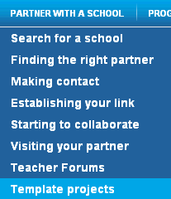
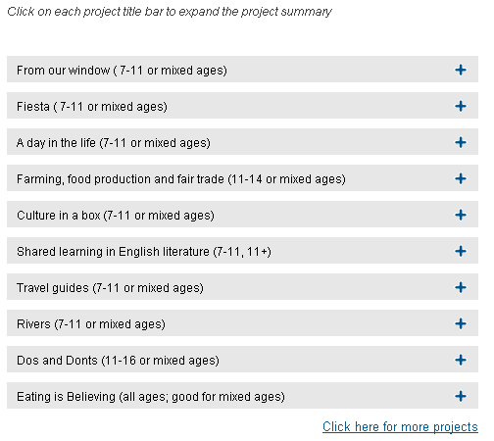
Click Template projects from the dropdown
to download and use for free in the classrooms.

Slide 15
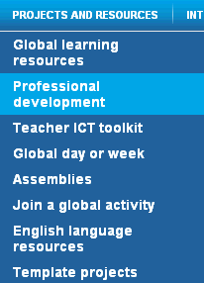
Information about online courses as part of continuous professional development can also be found here
Click here

Slide 16

In the Professional development page, click on courses and resources

Slide 17
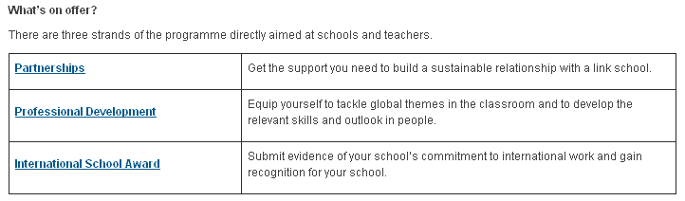
Click on Professional Development on the next page

Slide 18

Click on Sign up or Register now

Slide 19
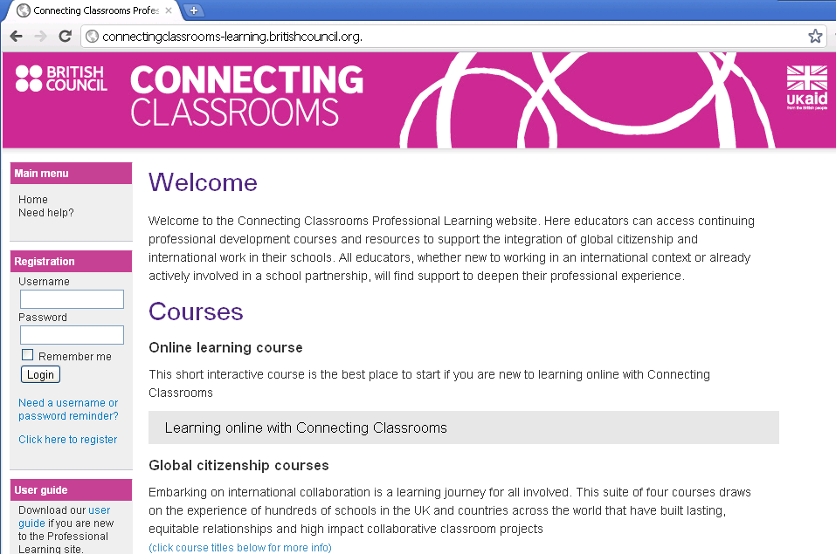
Enter username and password to get started
http://connectingclassrooms-learning.britishcouncil.org./

Slide 20
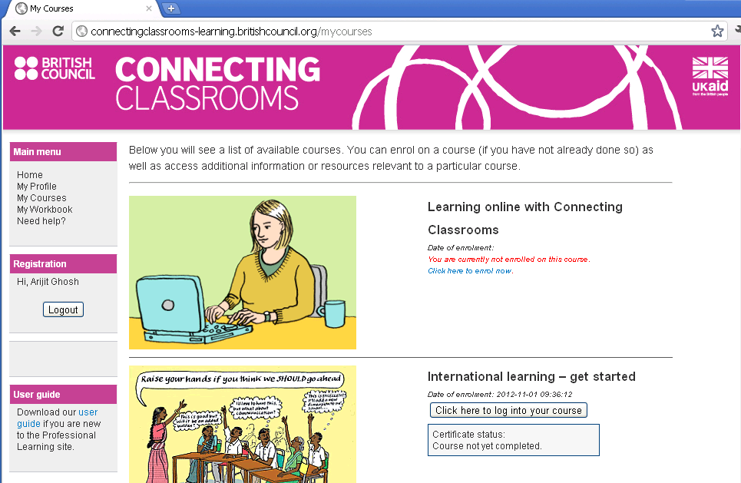
Post login you will find various online courses that can be completed at one’s leisure

Slide 21
Click on Partnerships to get all relevant information about partnerships and grants

Slide 22

This page provides all the relevant information about partnerships
http://schoolsonline.britishcouncil.org/programmes-and-funding/linking-programmes-worldwide/connecting-classrooms/partnerships

Slide 23
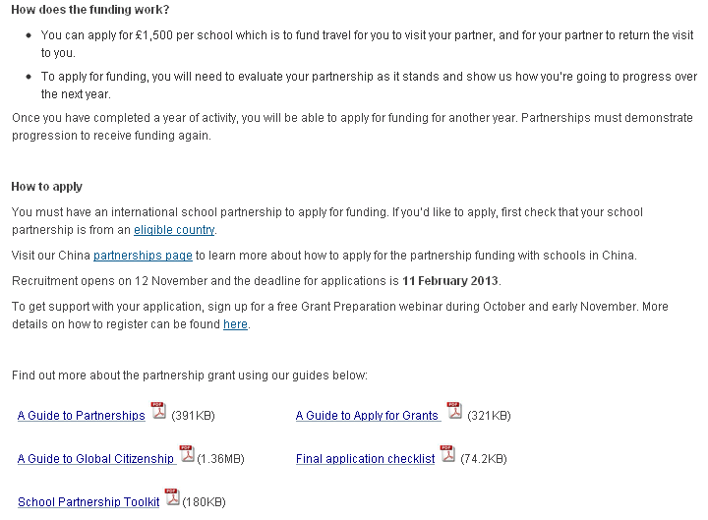
Downloadable pdfs offer as helpful guides

Slide 24
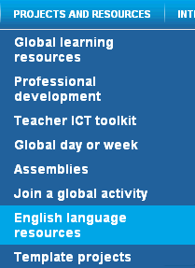
Information about several English language resources can also be found here
Click here

Slide 25
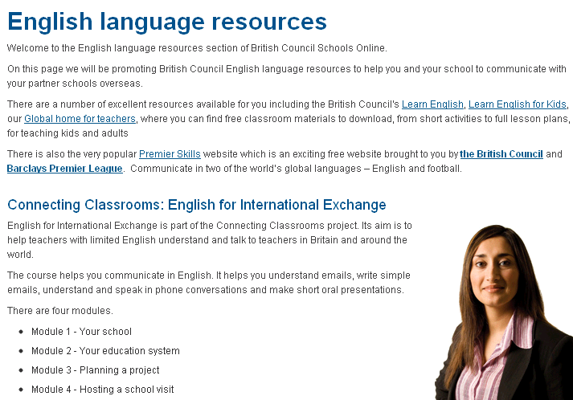
Click on these links to get access to the various English language resources

Slide 26
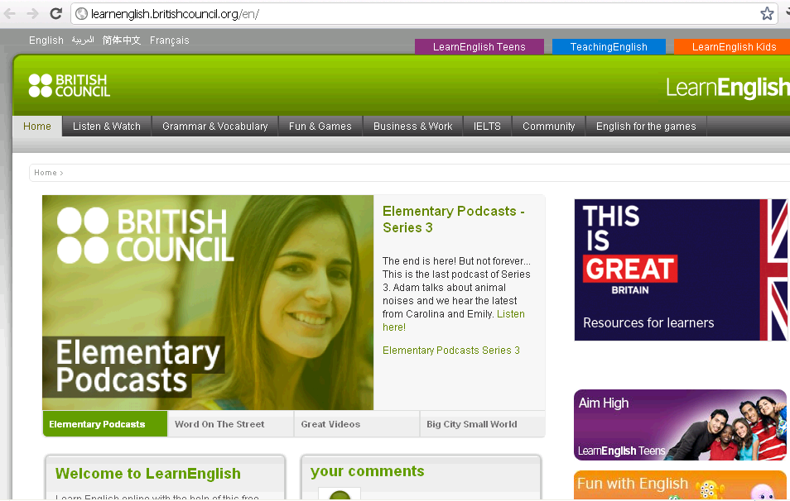
http://learnenglish.britishcouncil.org/en/

Slide 27
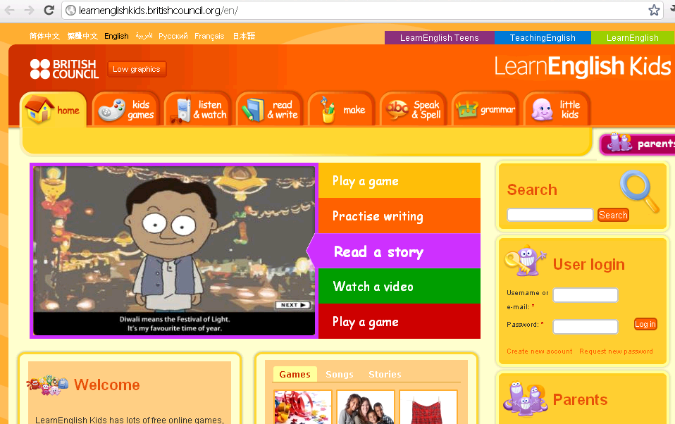
http://learnenglishkids.britishcouncil.org/en/

Slide 28
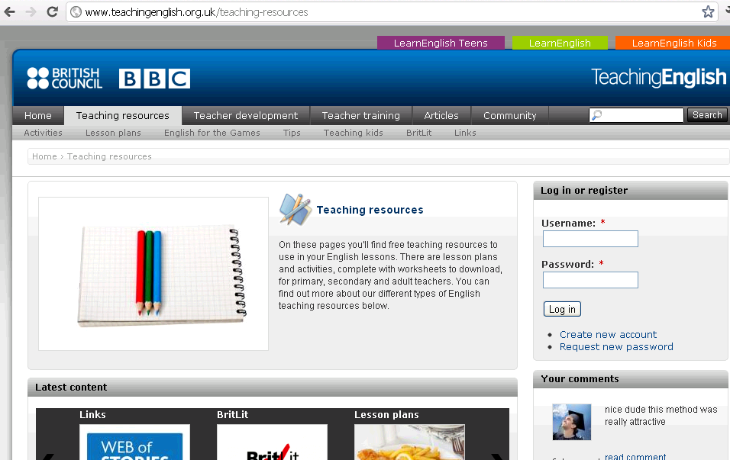
http://www.teachingenglish.org.uk/teaching-resources

Slide 29
British Council Partner Projects

Slide 30
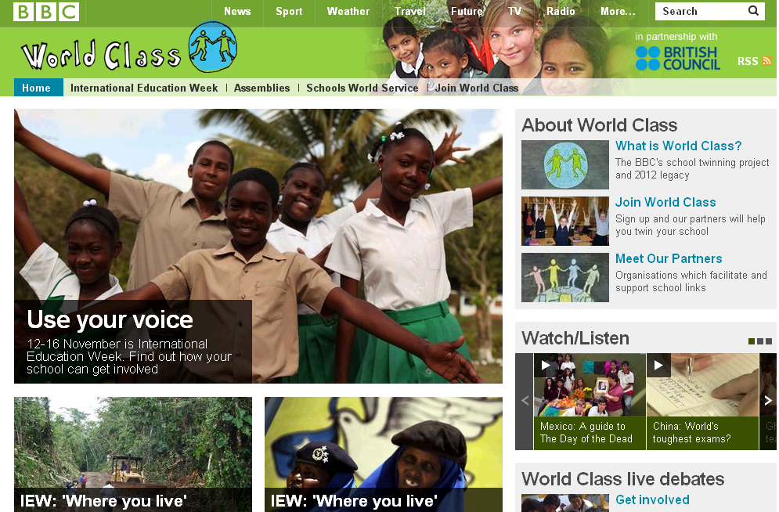
BBC World Class
http://www.bbc.co.uk/worldclass/
A school twinning project with a mission to support teachers in developing school-to-school partnerships, encouraging pupils to share creative work inspired by the Olympics.
World Class is BBC's global citizenship project for schools and works in partnership with the British Council.

Slide 31
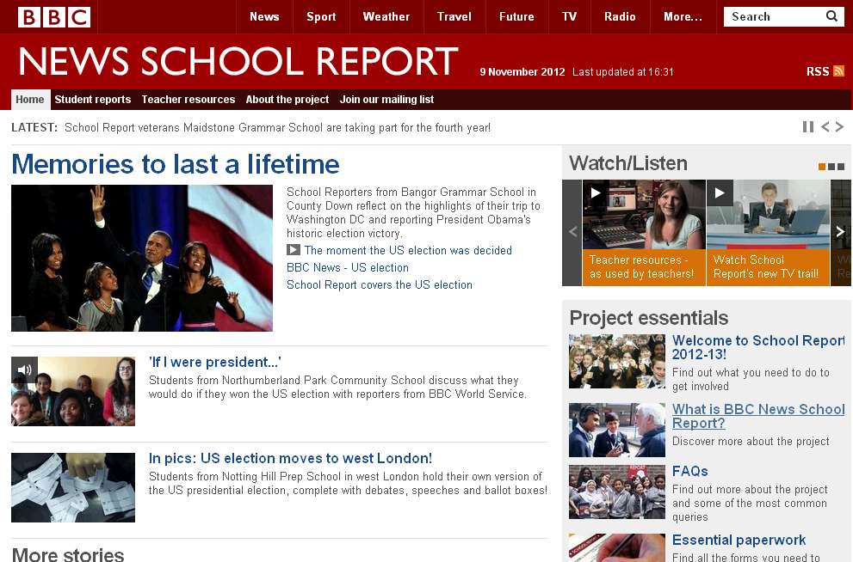
BBC News School Report
http://www.bbc.co.uk/schoolreport/
The project aims to engage young people with news and international current affairs, hear young people’s voices and stories, and encourage young people to think about the ethics of news-making. Students aged between 11 and 16 will work together to set their news agenda and publish stories that are important to them in their own words.

Slide 32

100 Words
http://www.100wordplay.com/
100 Words is a project for young people that unlocks their creative potential and creates global connections.
The project aims to capture the essence of a language and culture in thousands of short plays and films - each written using just a hundred words.

Slide 33
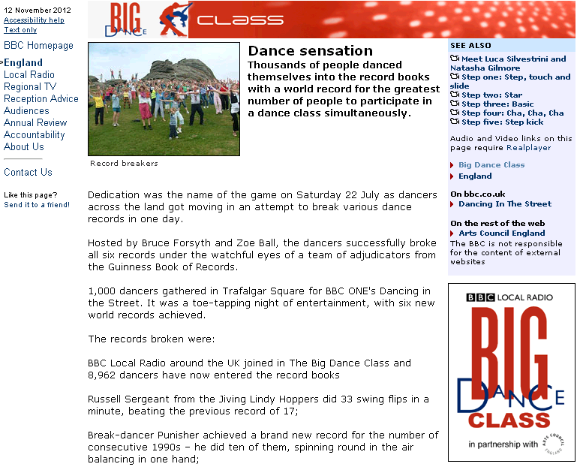
Big Dance
http://www.bbc.co.uk/england/bigdanceclass/
Big Dance is funded by Legacy Trust UK, Arts Council England, Greater London Authority, Creative Scotland, Arts Council Wales and Foundation for Sport and Arts was initiated and led by the Mayor of London in 2006.
In 2012 it is the UK’s biggest celebration of dance. Thousands of events are taking place in all dance styles, as part of the London 2012 Festival, the culmination of the cultural Olympiad.

Slide 34
Thank You
In case of queries, please feel free to write to: arijit.ghosh@britishcouncil.org

